Slide 1
Virtual Machine

Slide 2
Obtaining Virtual Box
Visit www.virtualbox.org and click on the download tab. Download the virtualbox platform packages for your appropriate system and install the software.

Slide 3
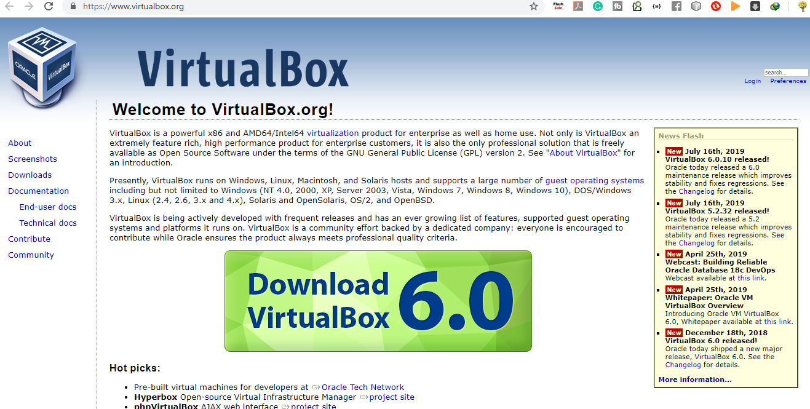

Slide 4
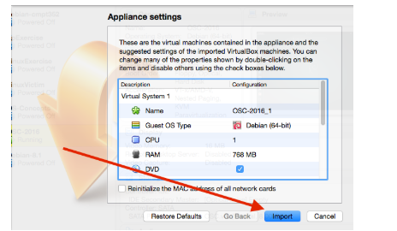
Installation as a VirtualBox Appliance
Click here to download the file OSC-2016.ova Double-click on the downloaded file. This will open the following window

Slide 5
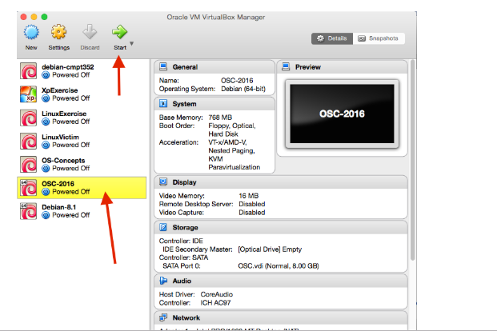
Running Linux
Highlight the virtual machine you wish to run (OSC-2016) and click on the Start button:

Slide 6
This will commence the Linux boot process. The default username is oscreader and the password is osc as well There is a root user and the password is osc The home screen contains a link to the source code for
Operating System Concepts

Slide 7
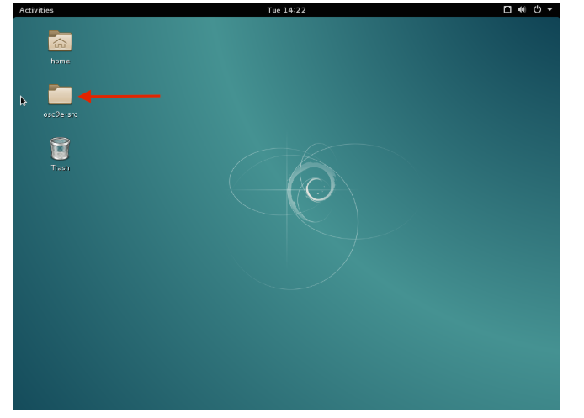

Slide 8
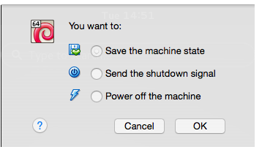
Exiting Linux
If you close the window running the virtual machine application, you will be presented with the following dialog box:
We recommend you choose the "Power off the machine" option.

Slide 9
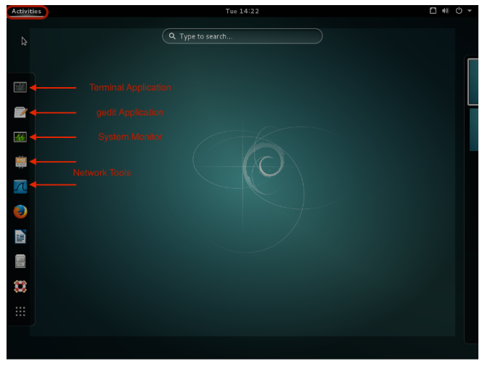
Running Applications
If you click on the Activities button, a side bar will appear with a list of useful applications

Slide 10
There are no graphical development tools built-in. Rather, you will have to use a
command line Applications -> Accessories -> Terminal where you will find gcc, our C compiler. There is also an editor - gedit Applications -> Accessories -> gedit Text Editor However this is a text editor only. You can use it to edit your C files,
yet you will have to
compile it using the command line.

Slide 11
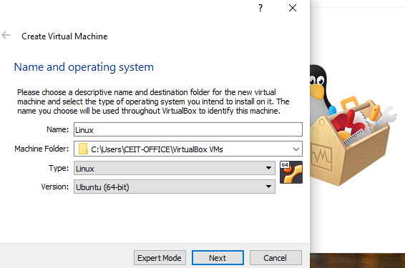

Slide 12
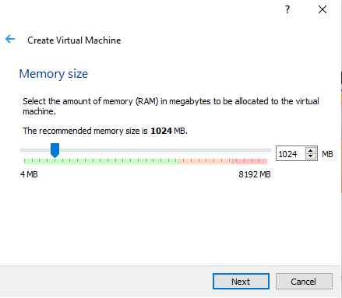

Slide 13
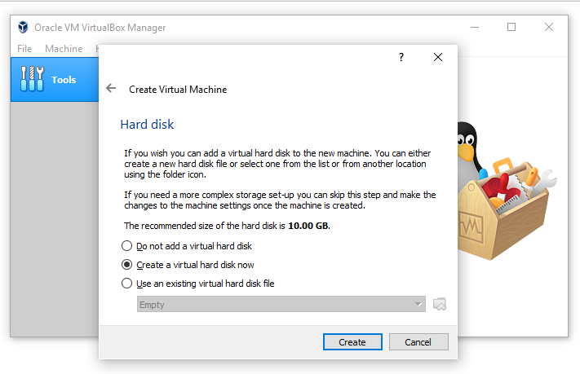

Slide 14
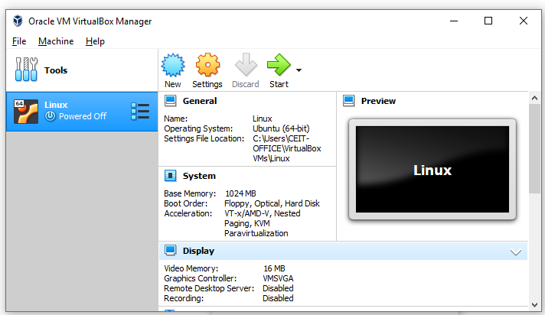

Slide 15
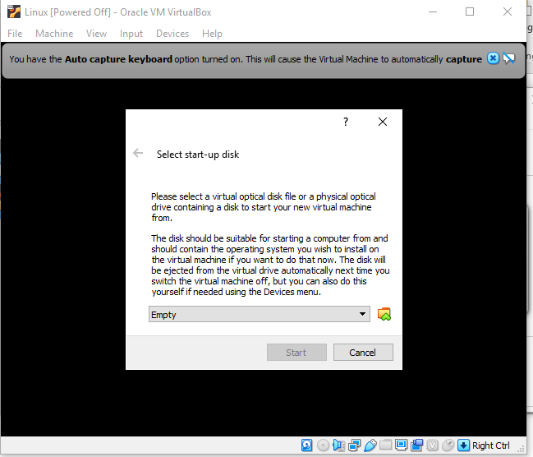

Slide 16
Thankyou

